Slide 1

Ethereum and Smart Contracts
SoftUni Team
Technical Trainers
Software University
http://softuni.bg

Slide 2

Table of Contents
Ethereum Concepts
A look at the blockchain
Smart Contracts

Slide 3
Questions
sli.do #B-Chain-Intro

Slide 4
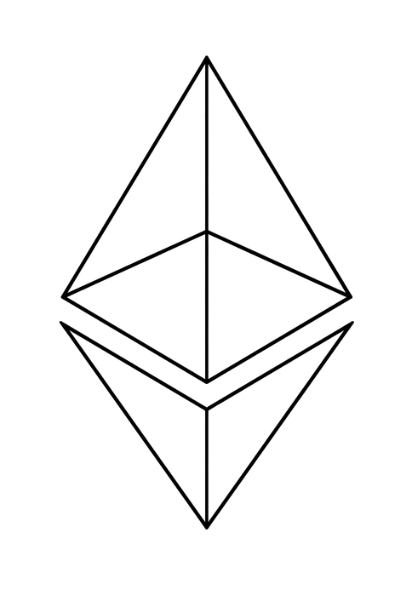
Ethereum
The “World Computer”

Slide 5
Ethereum
One of the many blockchain platforms out there
Decentralised and programmable
A platform and executing environment for decentralised applications and smart contracts, where anyone can set their own arbitrary rules for ownership, transaction formats and state transition functions
Backbone of the Ether cryptocurrency
A transactional ledger
Public

Slide 6
Centralisation in Practice - #1
Mainframe
Mainframe
Central storage and processing power
Client-Server
Client-Server
Client-to-server networks
Peer-to-Peer
Client-to-client operations
Time
Time
Cloud
Distributed server infrastructure and management
Peer-to-Peer over Cloud
Node driven networks
Decentralisation
Geographically dispersed storage and processing

Slide 7
Centralisation in Practice - #2
Governments
Central authority, changes rules
Organisations
Disfunctional, malicious
Networks
Insecure, monitorable
Web Applications
Hackable, poor Admin security
Databases
Easily manipulatable, no audit capability
Servers & Storage
Prone to theft and analysis

Slide 8
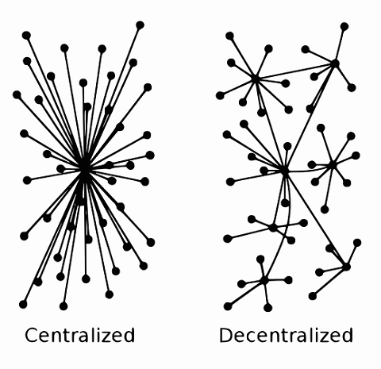
Decentralisation Definition
In IT terms:
many physical systems on a network, sharing the same content
In political terms:
No one has authority
Bonus”: some define “logical centralisation”:
Logically organised over a decentralised structure

Slide 9
Decentralisation Benefits
Attack resistance
Collusion resistance
Fault Tolerance
Drawbacks:
slow (as of 2018)
Distribution requires consensus mechanisms

Slide 10
Consensus and Networks
The problem of the Two Generals (1975/1978)
General 1 and General 2 must attack a common enemy together to defeat it
They must negotiate a time to attack together
The enemy *can* capture the messenger either way, so no one is sure if the other party has the message

Slide 11
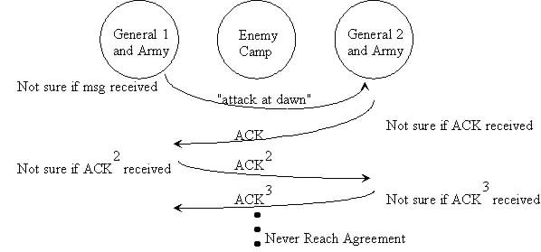
Consensus and Networks

Slide 12
Consensus and Networks
In real life Ethereum, nodes must communicate in a broadcast fashion
Communication across nodes is an asynchronous task and suffers delays (unequal between nodes)
This is why consensus algorithms that are 100% reliable are required to achieve the goal of the platform

Slide 13
The Byzantine Generals Problem
1982 by Lamport, Shostak and Pease
More than two generals
One or more generals can be traitors
The problem is transformed into a Commander – Lieutenant model, which must agree on the same decision
The final algorithm: consensus is based on the value of majority of the decisions a lieutenant observes.

Slide 14
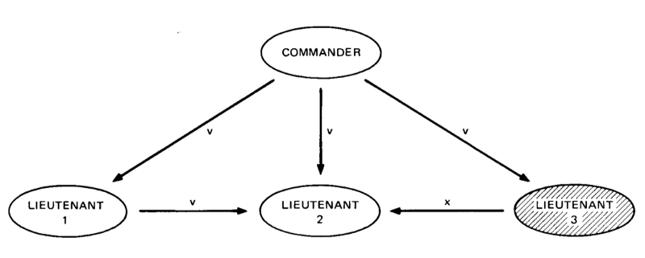
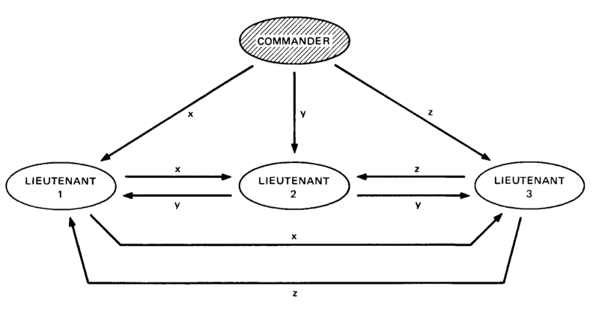
The Byzantine Generals Problem

Slide 15
Consensus and Byzantine Fault Tolerance
A design pattern (characteristic) of a system that deals with failures as described in the Byzantine Generals Problem
Exists in airplanes, nuclear plants, IoT, cars, SpaceX
Implemented in Ethereum
Prevents “false” transactions

Slide 16
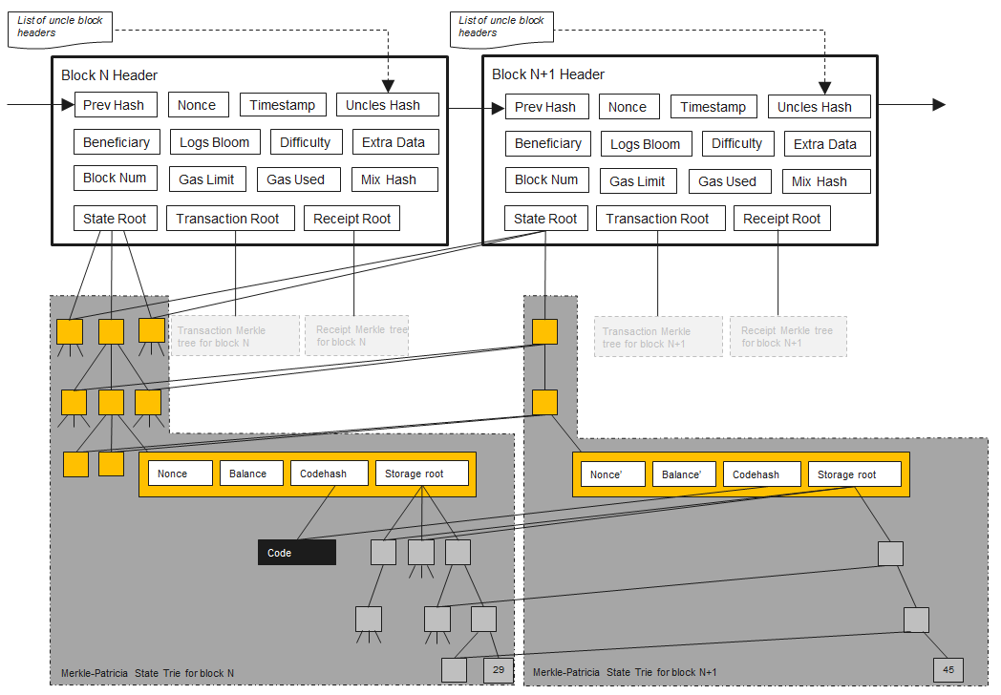
A Ledger through Blocks
https://ethereum.stackexchange.com/questions/268/ethereum-block-architecture

Slide 17
Ethereum Accounts
Each account has a 20-byte address
Externally owned accounts (with private keys)
aka “normal account” “user account”
Contract accounts
Has contract code
Storage

Slide 18
Account Object
Every account object contains 4 pieces of data:
Nonce
Balance
Code hash (code = empty string for normal accounts)
Storage trie root

Slide 19
Ethereum Transaction Types
Normal transactions move currency
Send tokens between accounts
Transactions to contracts
Similar to function calls to objects
You define which object to call, which function, and what data (if possible) to pass to it
Transactions to create contracts

Slide 20
Ethereum Transactions Have:
A transaction hash
Nonce
Gas price
Gas limit
To
Value
A few other things…

Slide 21
DApps
decentralised applications
For some:
An application that interacts with a blockchain
For others:
Open source
Consumes, stores and generates tokens
Stores all operations on a blockchain
Can be written in any language

Slide 22
Dapps Simple Architecture
Ethereum
Content references
IPFS
web3
DApp
Static content
Custom Data

Slide 23
Geth
Go Ethereum Client
The current latest version is v1.8.17
https://ethereum.github.io/go-ethereum/downloads/
Use it to run private blockchains for dev/test, etc.

Slide 24
Ethereum Networks
Main network – proof-of-work
Ropsten test network – best reproduction of production
Rinkeby test network - proof-of-authority based test network
Kovan – proof-of-authority
Local networks
Each node stores a copy of the entire blockchain

Slide 25
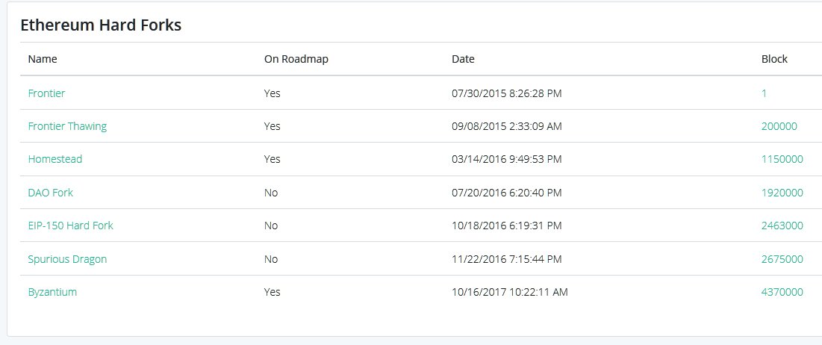
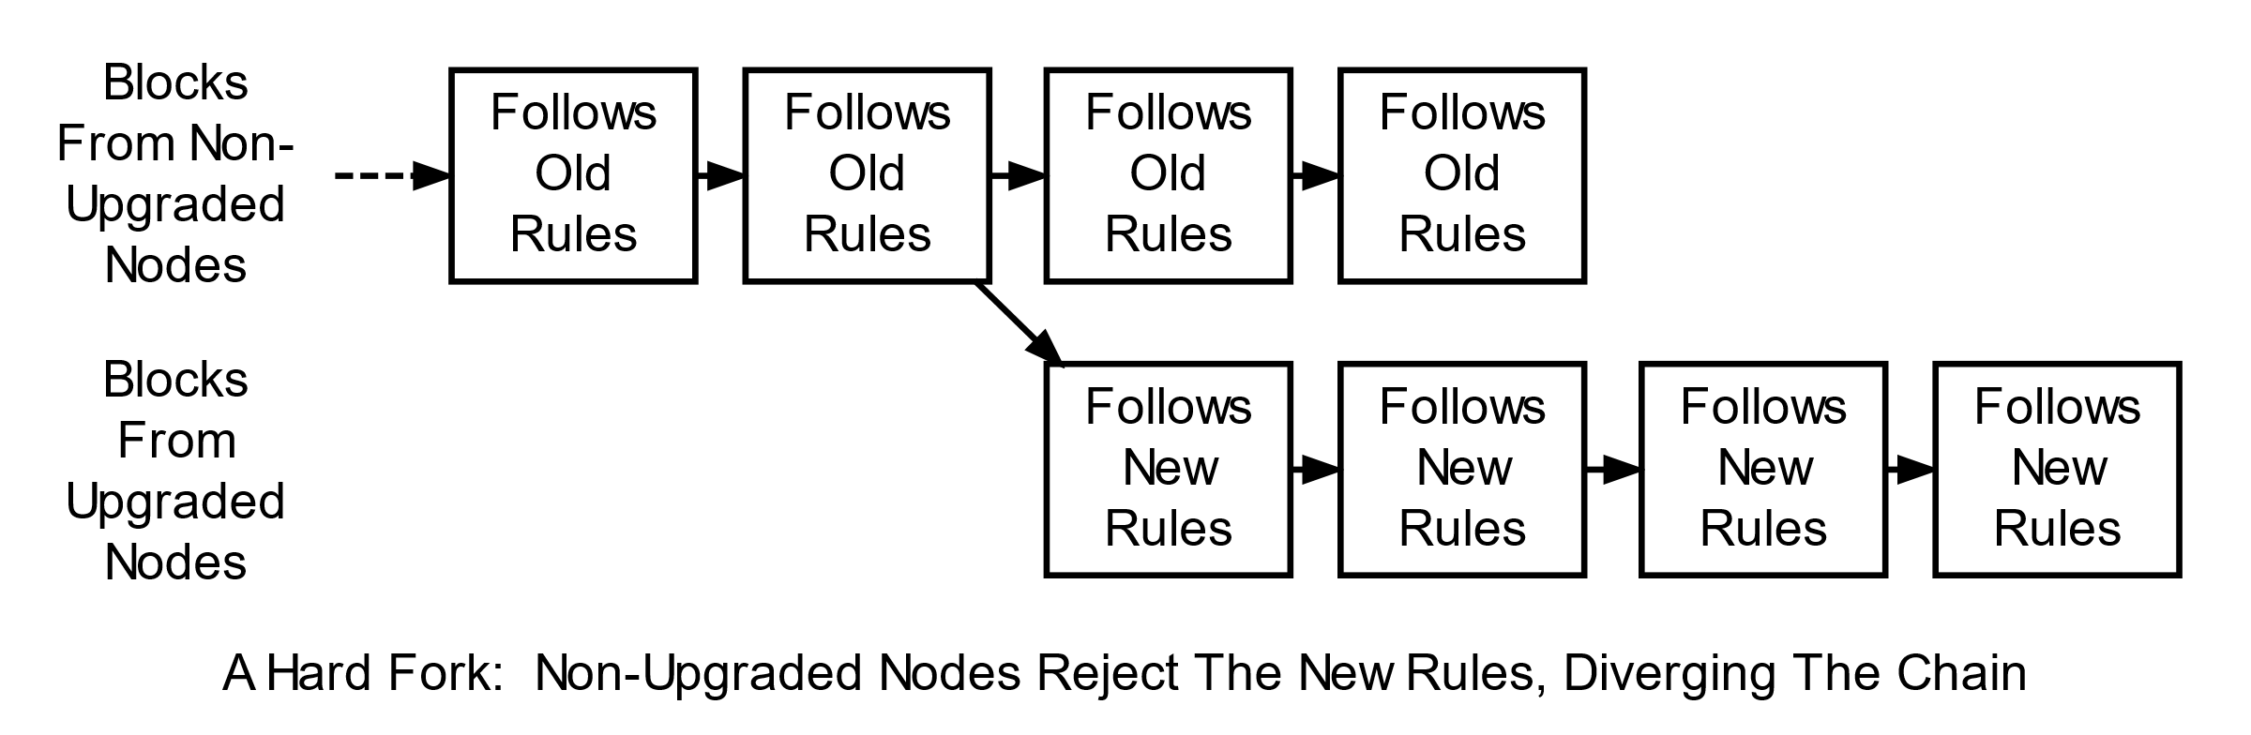
Ethereum Hard Forks
https://www.investopedia.com/terms/h/hard-fork.asp

Slide 26
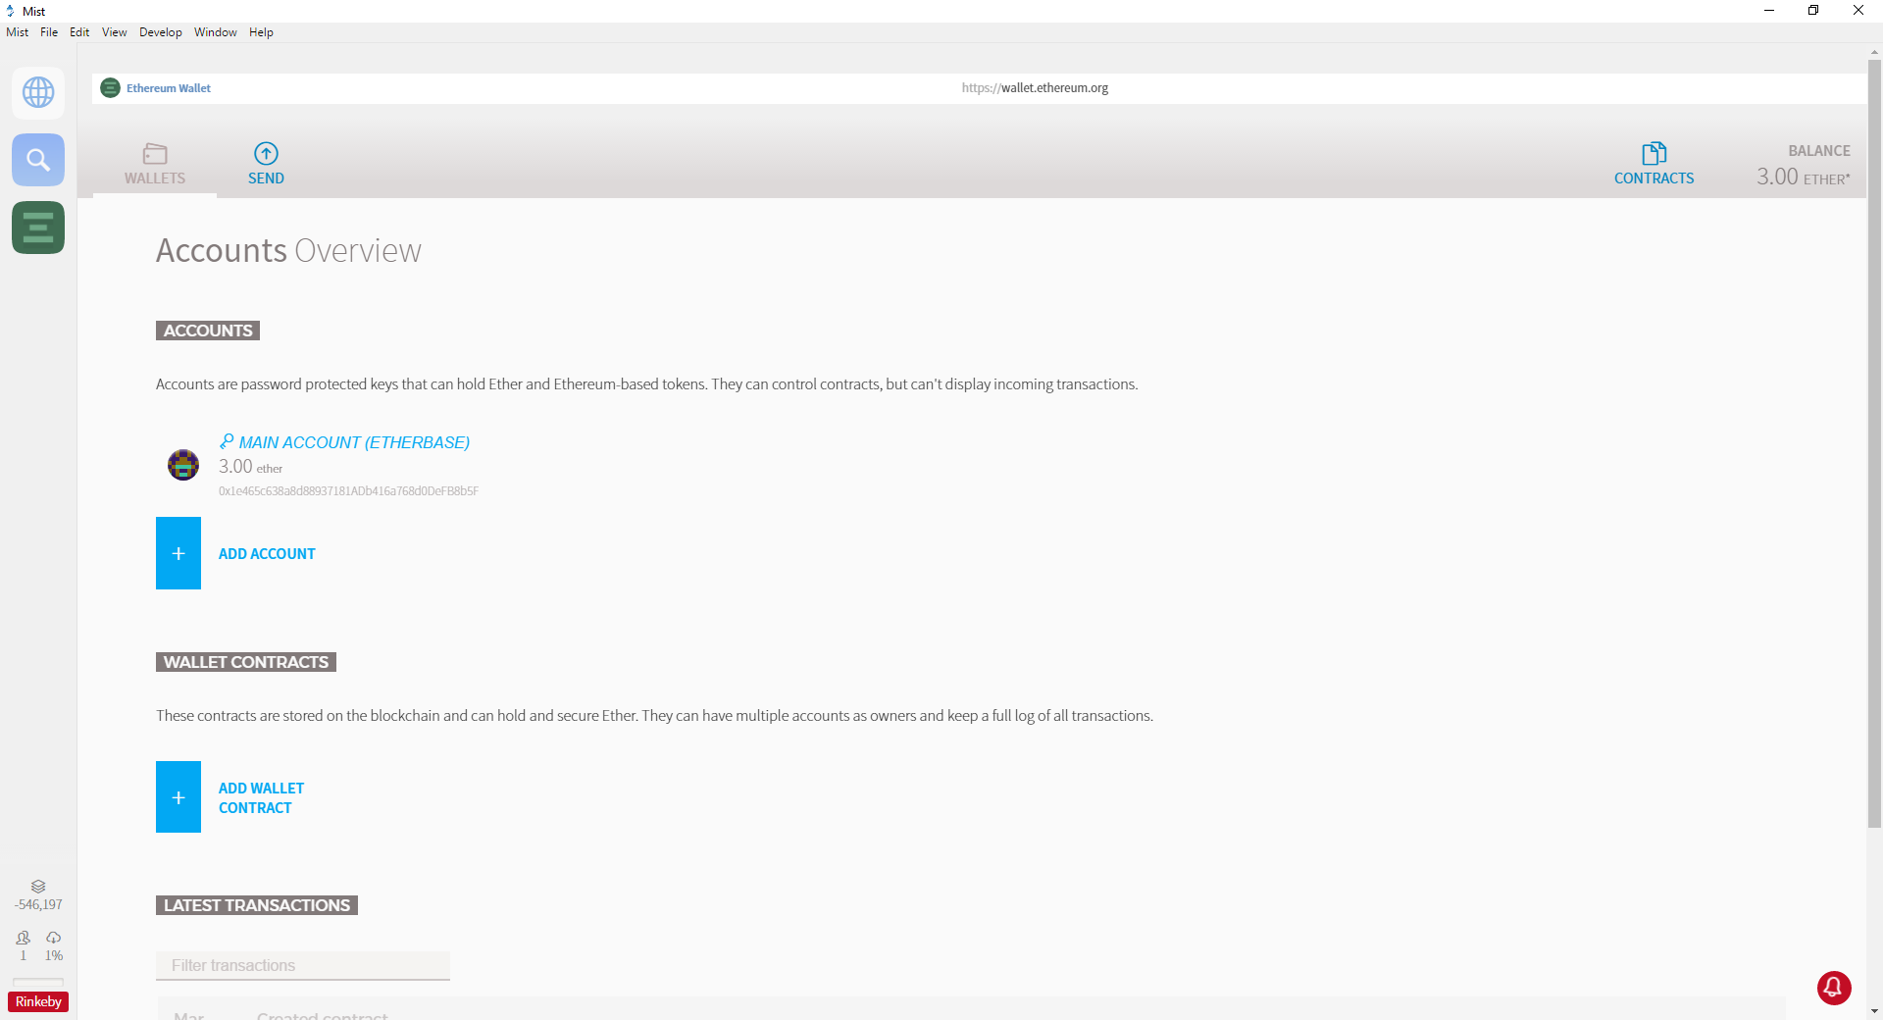
Mist
A “browser” tool for Ethereum

Slide 27
Ethereum Tokens
ERC20 – the only Final token standard
Name, symbol, decimals, totalSupply, balanceOf, transfer, transferFrom, approve, allowance
https://github.com/ethereum/EIPs/issues/827
ERC223 – Enhances ERC20 with support for token rejection
ERC721 – a non-fungible token
Many other ERC’s suggesting alteration:
https://github.com/ethereum/EIPS

Slide 28
The Industry Problems of Ethereum
Privacy & Traceability
Partner Confidentiality
Transaction Cost
Off-chain Storage
Latency and transaction speed
Accessibility of skills, knowledge and development power
Trust in platform success
Energy

Slide 29
Ethereum EIPs and ERCs
Ethereum Improvement Proposals
Ethereum Request for Comments

Slide 30
Applications
Medical
Insurance
Logistics
Cross-Partner Transactions
Automotive

Slide 31

Smart Contracts
Better than paper contracts…

Slide 32
Smart Contracts in Ethereum
Code that runs in an EVM
Manipulates data and state
Decentralised due to the blockchain
Autonomous
Immutable
Uncensored and uncontrolled
Custom rules of trade
“Open-source”

Slide 33
Ethereum Smart Contract Capabilities
Read/write data in storage
Execute functions (code)
Send transactions
Interact with other contracts (call them)

Slide 34
Smart Contracts in Business
Model complex and practical rules
Can be mapped to real-world assets and applications
Cannot back out – software does what it is written to do
I promise to send you 1 ETH if you give me 5 stars
Guaranteed to execute correctly (*)
Publicly visible, eliminating the need for trust

Slide 35
Simple Smart Contract Code Example
contract NameRegistry {
mapping (address => bytes32) names;
function register(bytes32 name){
names[msg.sender] = name;
}
function getName(address addr) returns (bytes32 name){
return names[addr];
}
}
Notes:
Smart contract example, with nothing lega at all ☺

Slide 36
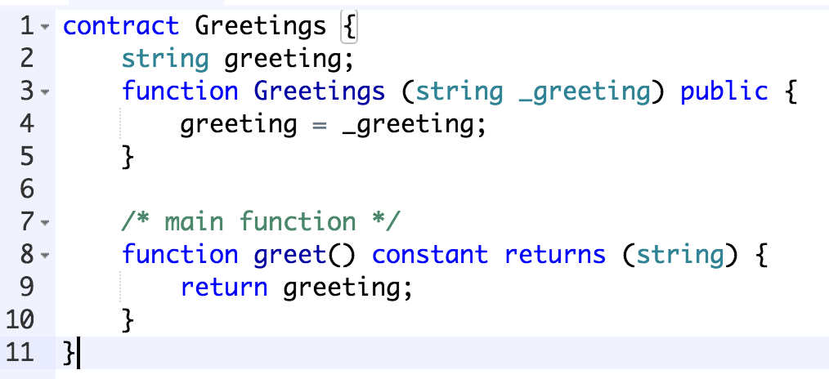
Example
What other see on the blockchain
6060604052604051610250380380610250833981016040528...
PUSH 60
PUSH 40
MSTORE
PUSH 0
CALLDATALOAD
.....
What you write
What people get from the disassembler

Slide 37
Smart Contract Applications
Define and build cryptocurrencies
Public records
Implement financial derivatives
Voting systems
Decentralized organizations
Data feeds
Title registries
Public messages
Crowdfunding
ICO facilitation
Thousands of other use cases

Slide 38
Immutability
Once deployed, a contract’s code cannot change
When developing, test on alternative networks
Many have adopted “strategies” and patterns to work around this feature

Slide 39
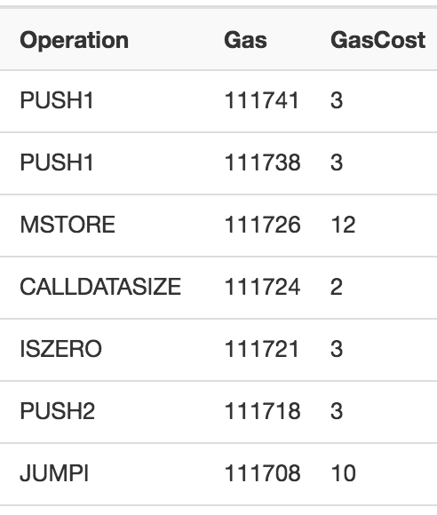
Gas and Fees
When doing work on the Ethereum chain, you must pay a “fee” per computational step
Calculated in Gas, paid in ETH
You pay even if your transaction fails
Gas limit
Gas price
TX Fee = gas limit * gas price
Prevents everyone from doing anything useless on the chain

Slide 40

Summary
Check out Ethereum, the most popular blockchain for decentralised applications
Check out blockchain based startups and their Smart Contracts
Explore geth, and the Ethereum chain on etherscan.io

Slide 41
Reading List
https://github.com/ethereum/wiki/wiki/Glossary - a good resource for terminology
https://github.com/ethereum/wiki/wiki/White-Paper - the Ethereum white paper
https://medium.com/loom-network/understanding-blockchain-fundamentals-part-1-byzantine-fault-tolerance-245f46fe8419
https://www.youtube.com/watch?v=tWuN2R2DC6c – Nick Szabo on Smart Contracts

Slide 42
Homework
What is the Contract Address of the CryptoKitties project?
To what token specification does the CryptoKitties token conform to?
BONUS for devs: which line of code in the CryptoKitties contract defines that the contract conforms to the token standard?
What is the last successful transaction hash on the CryptoKitties contract before 2018-10-19 16:00 UTC (start of lecture)?
Which contract function did it call?
What was the gas limit and gas consumption?
How much did the transaction cost in Ether?
What is the number of the block?
Who mined the block of the transaction?
How many transactions occurred on the block?

Slide 43
Homework Tips
Use https://etherscan.io
Enjoy exploring the events on the blockchain
Learn what all elements on the screens of etherscan.io mean

Slide 47

Trainings @ Software University (SoftUni)
Software University – High-Quality Education, Profession and Job for Software Developers
softuni.bg
Software University Foundation
http://softuni.foundation/
Software University @ Facebook
facebook.com/SoftwareUniversity
Software University Forums
forum.softuni.bg

